Slide 1

Self-Balancing Unicycle
Introduction
Recap
Controls
Code
Testing
Problems
Lessons
Robot
Suggestions
Conclusion
Client: Andy Chang (National Instruments)
Supervisor: Dr. Robert Throne
Leader: Kevin Collins
Members: Spencer Carver
Ander Solorzano
Ruffin White-Magner
Team
G
Notes:
Kevin

Slide 2
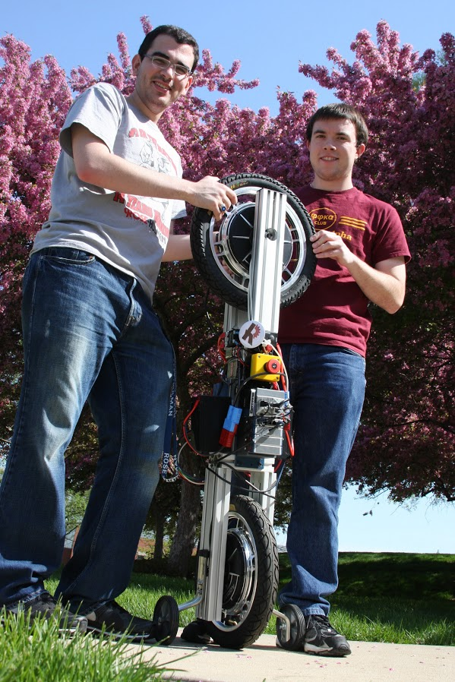
Introduction
Recap
Controls
Code
Testing
Problems
Lessons
Robot
Suggestions
Conclusion
Build a self-balancing robotic unicycle for National Instruments (NI), using NI components where possible
Notes:
Kevin –

Slide 3
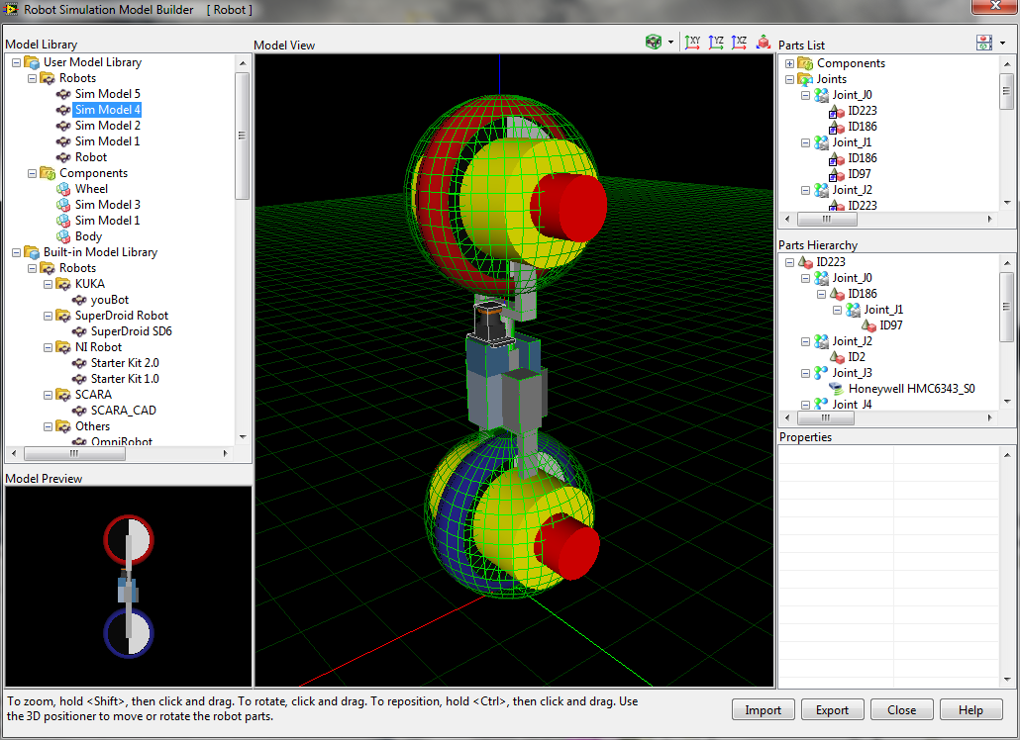
Introduction
Recap of Fall
Controls
Code
Testing
Problems
Lessons
Robot
Suggestions
Conclusion
Notes:
Kevin

Slide 4
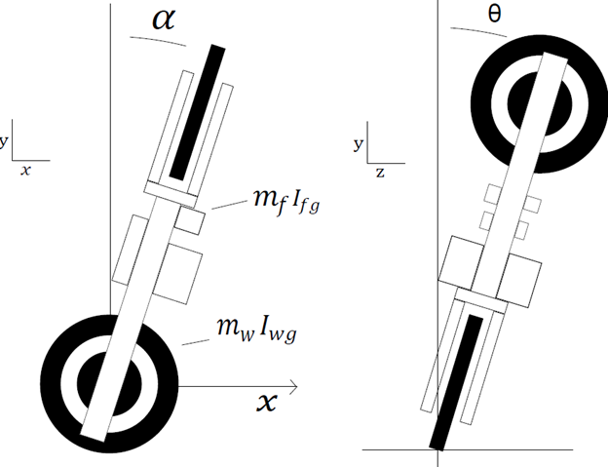
Introduction
Recap of Fall
Controls
Code
Testing
Problems
Lessons
Robot
Suggestions
Conclusion
Notes:
Kevin

Slide 5
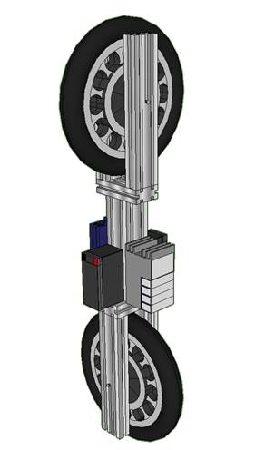
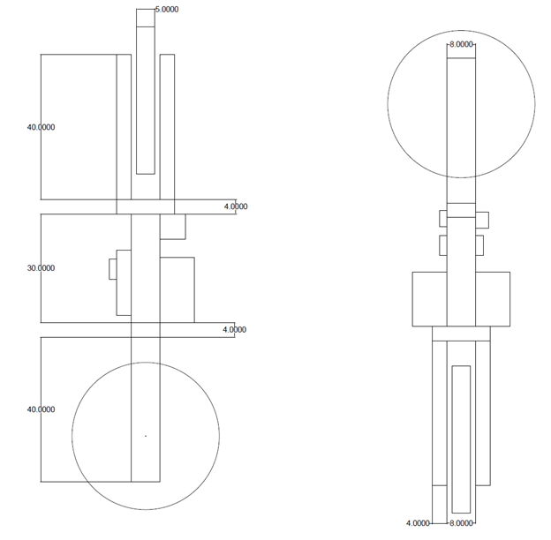
Introduction
Recap of Winter
Controls
Code
Testing
Problems
Lessons
Robot
Suggestions
Conclusion
Build a self-balancing robotic unicycle for National Instruments (NI), using NI components where possible
Notes:
Kevin

Slide 6
Introduction
Recap
Control System
Code
Testing
Problems
Lessons
Robot
Suggestions
Conclusion
Notes:
Ander

Slide 7
Introduction
Recap
Controls
Code
Testing
Problems
Lessons
Robot
Suggestions
Conclusion
Notes:
Spencer

Slide 8
Recap
Controls
Code
Testing Plan
Problems
Lessons
Robot
Suggestions
Conclusion
Notes:
Spencer

Slide 9
Controls
Code
Testing
Problems Encountered
Lessons
Robot
Suggestions
Conclusion
Notes:
Spencer

Slide 10
Code
Testing
Problems
Other Lessons Learned
Robot
Suggestions
Conclusion
Notes:
Ruffin

Slide 11
Testing
Problems
Lessons
Robot
Suggestions
Conclusion
Notes:
Ruffin

Slide 12
Problems
Lessons
Robot
Recommendations
Conclusion
Notes:
Ruffin

Slide 13
Lessons
Robot
Suggestions
Conclusion - Questions?
Notes:
Ruffin

